Slide 1
Chapter 3: Measures of Central tendency
Part-1

Slide 2
Learning Outcomes
After Completing the chapter ,you will able to :
Compute the different types of mean, median and mode.
Understand the applications of different types of measures of central tendency.

Slide 3
Contents
    From this lecture, you are going to learn…
What is measures of central tendency?
Types of measures of central tendency
Discussion of different types of Mean
Examples, Uses and limitations

Slide 4

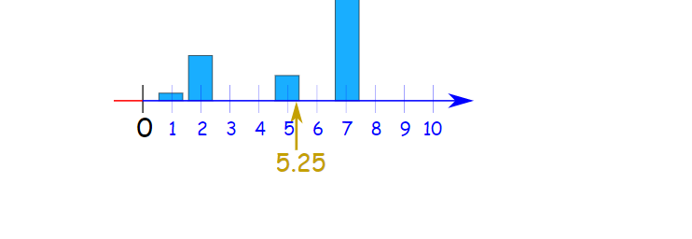
What is measures of central tendency?
A measure of central tendency is a summary statistic that attempts to describe a set of data by calculating the center point or typical value within that data set.
Average age to start schooling

Slide 5
Types of measures of central tendency
Measures of central Tendency
Mean
Median
Mode
Arithmetic
Mean
Weighted
Mean
Geometric
Mean
Harmonic
Mean

Slide 6
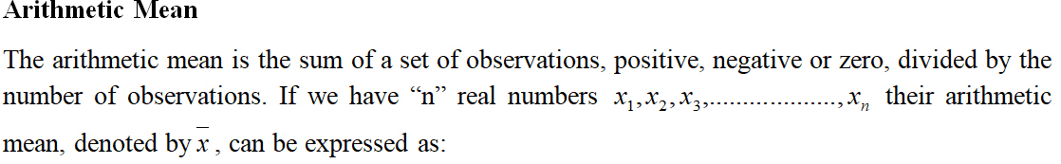

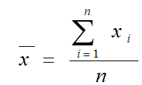
Arithmetic Mean(AM)

Slide 7




Example of Arithmetic Mean(AM)

Slide 8

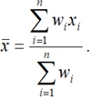





Weighted Mean(W.M)
Example-1: During a one hour period on a hot Saturday afternoon cabana boy Chris served fifty drinks. He sold five drinks for $0.50, fifteen for $0.75, fifteen for $0.90, and fifteen for $1.15. Compute the weighted mean of the price of the drinks.

Slide 9
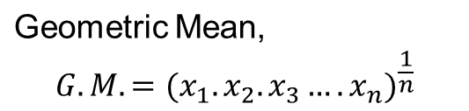



Geometric Mean(G.M)
=15

Slide 10


Geometric Mean(G.M)
Example:
Suppose the population growth rate from 2010 to 2013 were , 1.24, 1.26,1.29 and 1.31 respectively.
Find the geometric mean of these growth rates.
=1.27
So, the average growth rate is, 1.27.

Slide 11
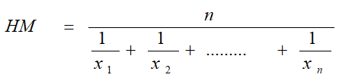
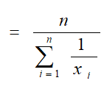
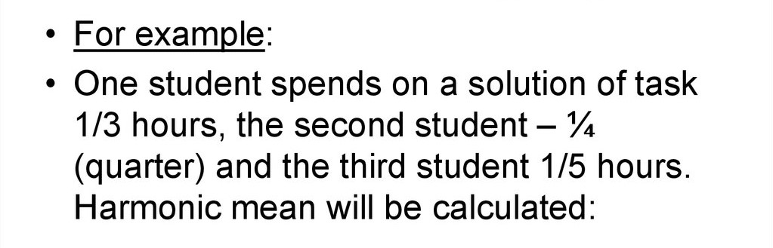
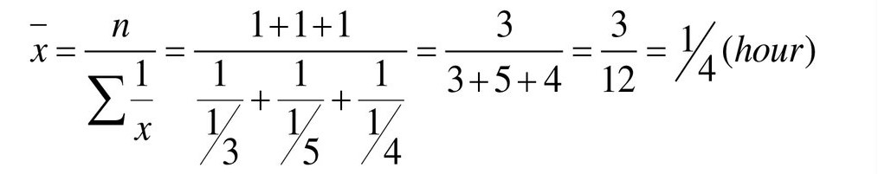
Harmonic Mean(H.M)
Harmonic Mean (HM):
The harmonic mean is the number of variables divided by the sum of the reciprocals of the variables.
Solution:
1/4

Slide 12
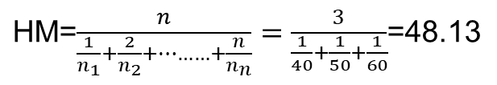

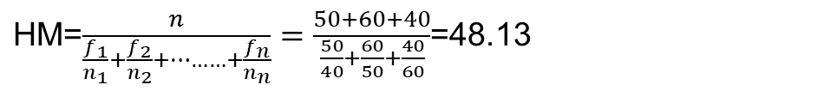
Harmonic Mean(H.M)
Example: A car travels 50 miles at 40 mph, 60miles at 50mph and 40 miles at 60mph.What is the average speed of the trip?
Solution: The distance is 50 miles, 60miles and 40 miles.

Slide 13
Uses and Limitations of A.M,G.M and H.M
Types of mean | Uses | Limitations
Arithmetic Mean(A.M) | It is easy to calculate and allow easy mathematical treatment. It has great application in Financial sectors. | Highly affected by extreme values.
Geometric Mean(G.M) | To find the averages percent increase in sales, production, growth etc. | All values must be positive and non zero.
Harmonic Mean(H.M) | Less affected by extreme values . It is appropriate for the situation when the average of fractions such as rates or multiples are desired. | Cannot compute for one or more zero values.

Slide 14


